Slide 1
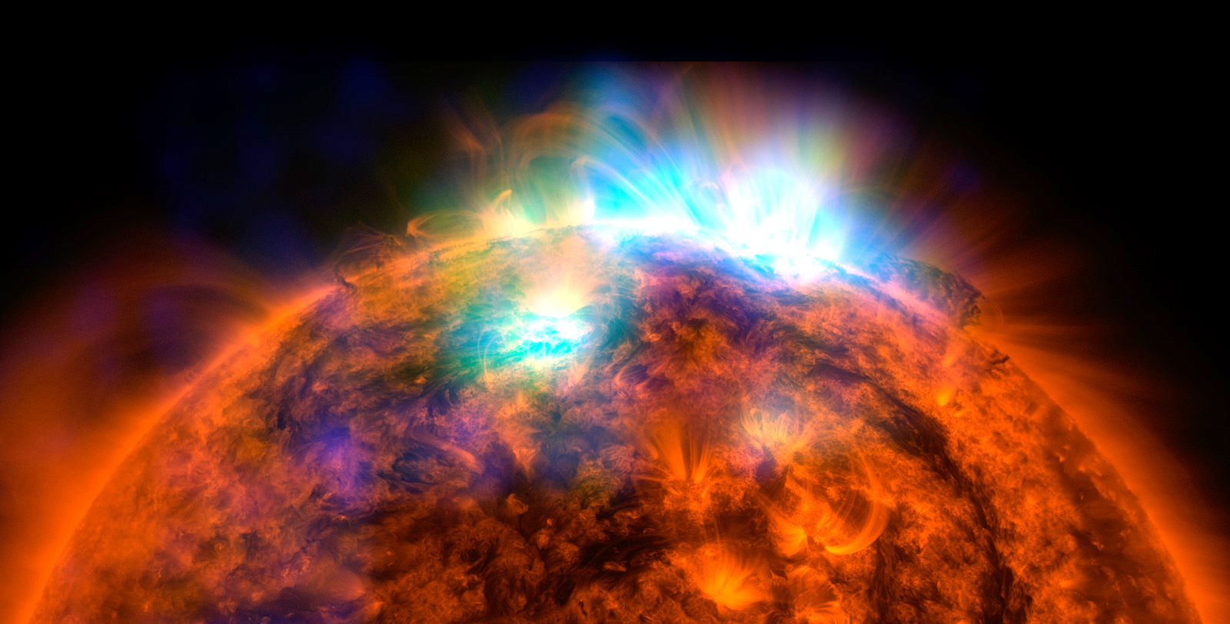
THE SOLAR SYSTEM
We will describe the structure of our solar system

Slide 2
Repeat the opposite word/phrase.
GRAVITY
PULL TOWARDS OBJECT

Slide 3
Repeat the opposite word/phrase.
ORBIT
PATH AROUND AN OBJECT

Slide 4
We will describe the structure of our solar system
TRACK WITH ME
READ WITH ME
We will identify the planets
We will compare the sizes of the planets, the sun and our moon
DECLARE THE OBJECTIVE
Read the learning objective to your partner.
Notes:
Learning Objectives contain concepts (nouns, big ideas), skills (verbs, measurable behaviours) and sometimes context (restricting or targeting conditions).
●Example: Students will be able to describe the concept of density and apply it to floating and sinking.
●
Success criteria are specific measurable outcomes that if met mean that the student has met the learning objective.
Examples:
•Students will be able to compare densities of substances using mass and volume.
•Students will be able to identify whether a solid or liquid will float or sink in a liquid based on their densities.

Slide 5
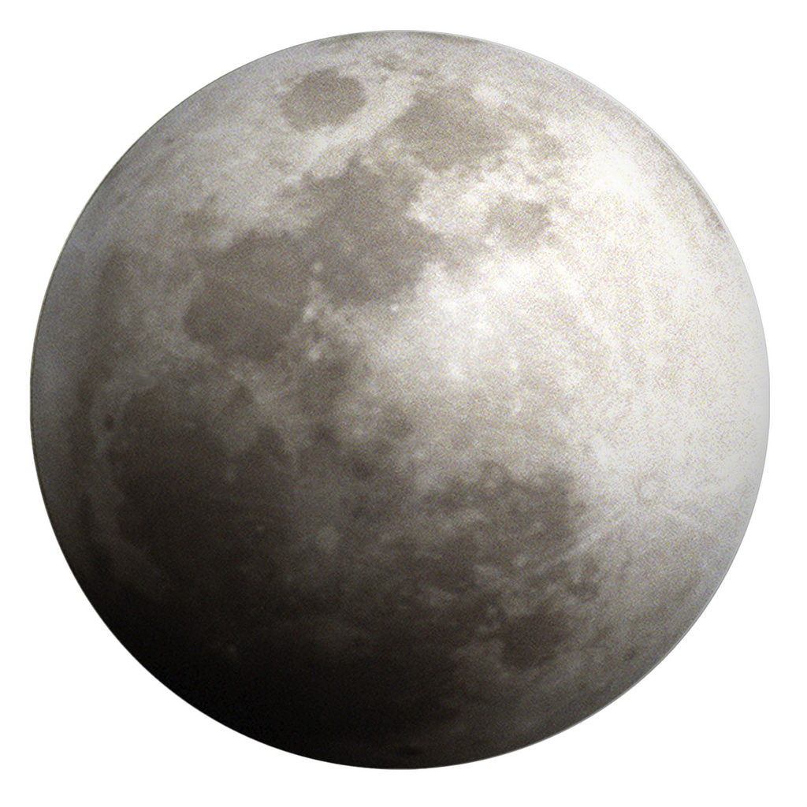
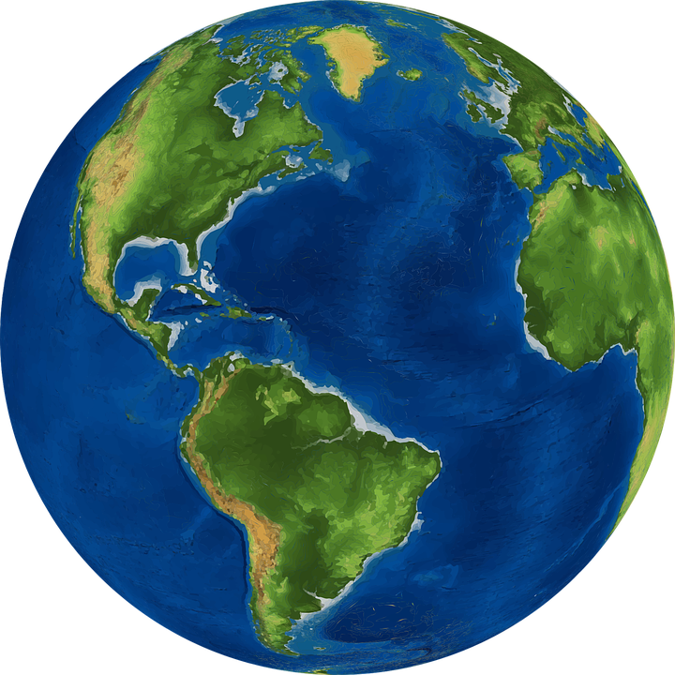
We will describe the structure of our solar system
Write down as many things that you can think of that exist in our solar system.
MAKE THE CONNECTION
Students, you already know that the sun, the moon and the Earth are part of the solar system.

Slide 6
We will describe the structure of our solar system
The Milky Way Galaxy is one galaxy₁ within the universe.
Our solar system₂ exists within the Milky Way Galaxy.
Our solar system contains the following:
A sun
8 planets
Dwarf planets
Planets’ natural satellites₃
CHECK FOR UNDERSTANDING
Order the following things from largest to smallest: Galaxy Solar System Universe Explain your answer.
DEFINITION
1 - a system of stars 2 - a star and the surrounding objects 3 - naturally occurring body which circles a planet

Slide 7
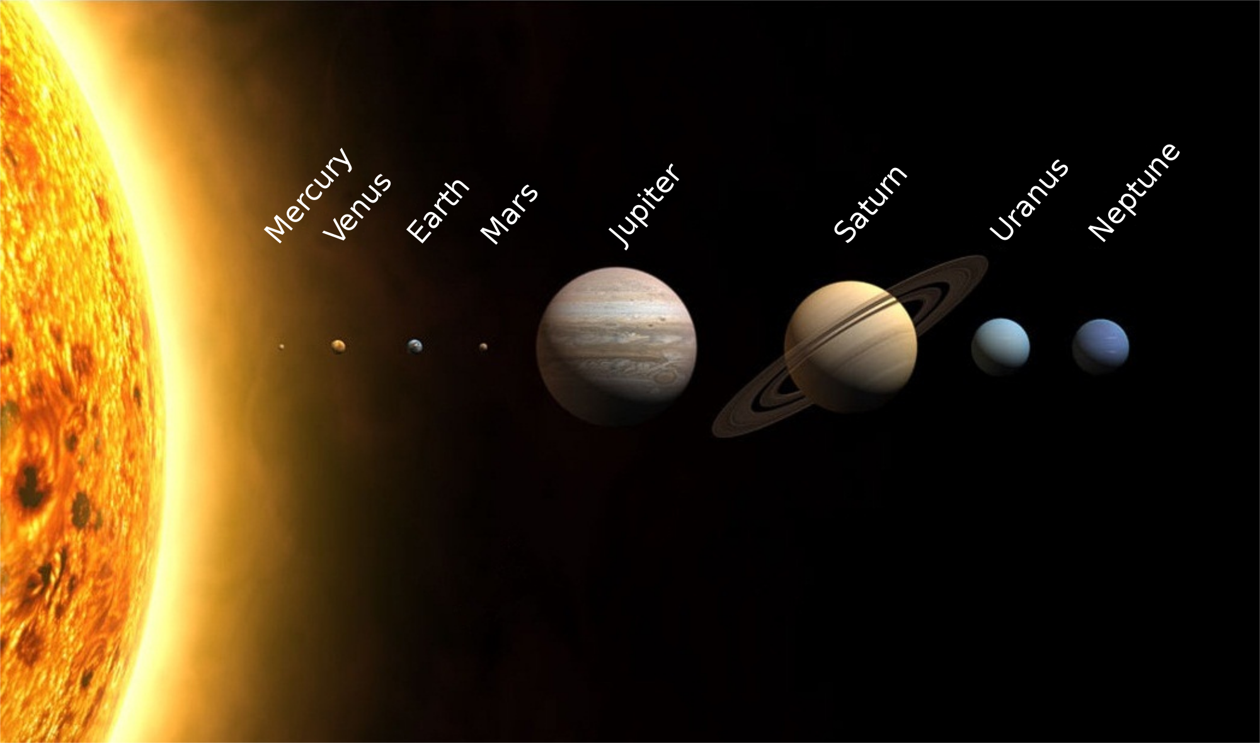
We will describe the structure of our solar system
There are 8 planets in our solar system.
There are 4 terrestrial planets, Mercury, Venus, Earth and Mars
There are 4 jovian planets, Jupiter, Saturn, Uranus and Neptune.
CHECK FOR UNDERSTANDING
Order the following planets from largest to smallest: Mercury Earth Neptune Jupiter Mars What can you say about the size of the jovian planets compared to the other planets?

Slide 8
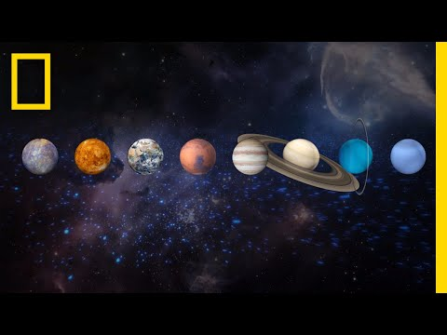
We will describe the structure of our solar system
CHECK FOR UNDERSTANDING
Answer the following questions during the video: What planet is the coldest? What planet is the hottest? What planet orbits on its side? Which planets are the gas giants?
Notes:
http://scaleofuniverse.com/

Slide 9
We will describe the structure of our solar system
Draw and label the planets of our solar system using the picture below.
Label the terrestrial planets on your diagram.
Label the jovian planets on your diagram.
Label the gas giants on your diagram.
Label the ice giants on your diagram.
CHECK FOR UNDERSTANDING
Why are several planets called gas giants? Explain your answer.
REMEMBER THE CONCEPT
Remember that the gas giants and the ice giants make up the jovian planets.

Slide 10
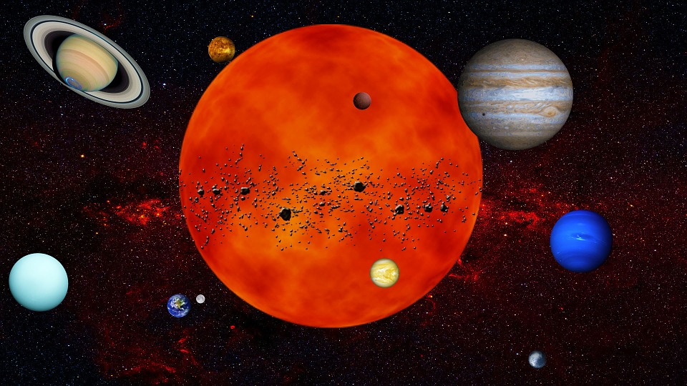
We will describe the structure of our solar system
Before we begin looking at the Earth and its relationship with the sun, we need to know some basics about our solar system.
CHECK FOR UNDERSTANDING
The Earth orbits the sun. What orbits the Earth? Explain your answer using gravity.

Slide 11
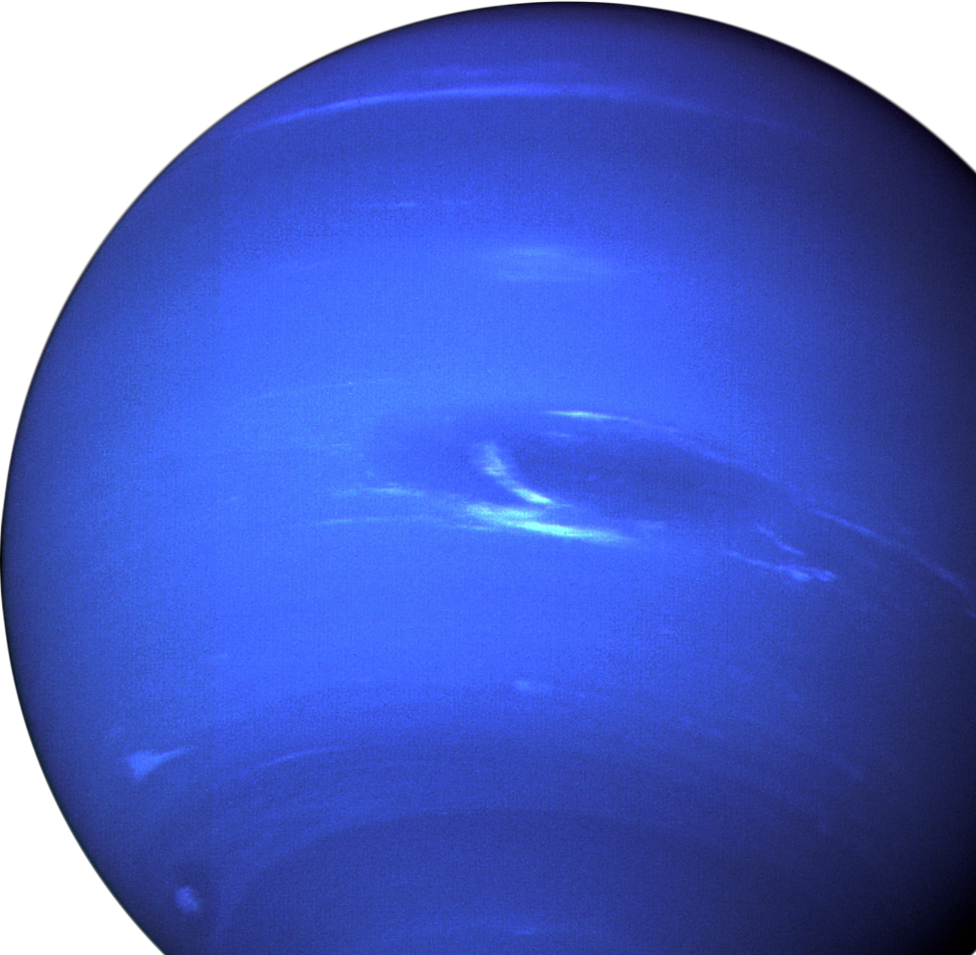
We will describe the structure of our solar system
Our solar system is in the Milky Way Galaxy.
There are 8 planets in our solar system which orbit the sun.
There are terrestrial planets and jovian planets.
The planets have different sizes and orbits.
There are dwarf planets, natural satellites and other smaller objects in our solar system.
CHECK FOR UNDERSTANDING
What are some differences between the terrestrial planets and the jovian planets?

Slide 12
We will describe the structure of our solar system
How many stars are there in our solar system?
What is Earth’s only natural satellite?
If you stood on Mercury, would the sun appear to be bigger or smaller? Explain your answer.
Create a poem to remember the order of the planets. For example, MVEMJSUN - My Vacuum Eats My Jellybeans Spilt Under the Nightstand
Create a poster on a planet within our solar system of your choice. Include the following facts:
Name
Size
Terrestrial or jovian planet
Satellites
CHECK FOR UNDERSTANDING
What is a satellite? Please provide an example.
REMEMBER THE CONCEPT
Remember that our solar system contains the following: A sun 8 planets Dwarf planets Planets’ satellites
Notes:
Please include tasks/questions here rather than just referring to a worksheet. This will save on photocopying and facilitate sharing with other schools.
Try and build tasks/questions which escalate through Bloom’s Taxonomy. This will help with differentiation.

Slide 13
We will describe the structure of our solar system
We will identify the planets
We will compare the sizes of the planets, the sun and our moon
CHECK FOR UNDERSTANDING
Check Success Criteria.

